Slide 1
December 21, 2024
REFORM TEXT ARTICLES TO CONDENSED SUMMARIES APPLYING TRANSFORMER MODEL CAPABILITIES WITH TRADITIONAL NLP METHODS
Presented by
Jhilmit Asri

Slide 2
TABLE OF CONTENT
Overview
Dataset
Theory
Practical
Results
Walkthrough

Slide 3
Text Summarization
Text Summarization is a natural language processing (NLP) task that condenses a lengthy text document into a shorter, more compact version while retaining the most important information and meaning. The goal is to produce a summary that accurately represents the content of the original text in a concise form.

Slide 4
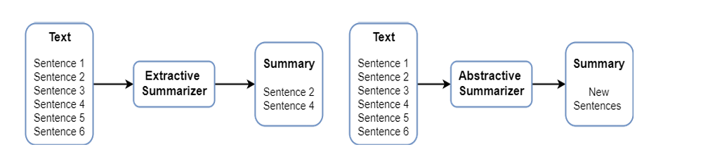
Text Summarization Types
Extractive and Abstractive Summarization

Slide 5
Dataset Overview
The WikiHow dataset primarily focuses on abstractive summarization tasks, creating concise summaries from detailed content.
It comprises over 230,000 article-summary pairs, extracted from the WikiHow website
The dataset consists of two separate data files. One file contains the Title, Headline, and Text as columns and the other has an extra Overview column.
Article Length: Articles average about 580 words.
Summary Length: Summaries average around 62 words, shorter than the articles.

Slide 6
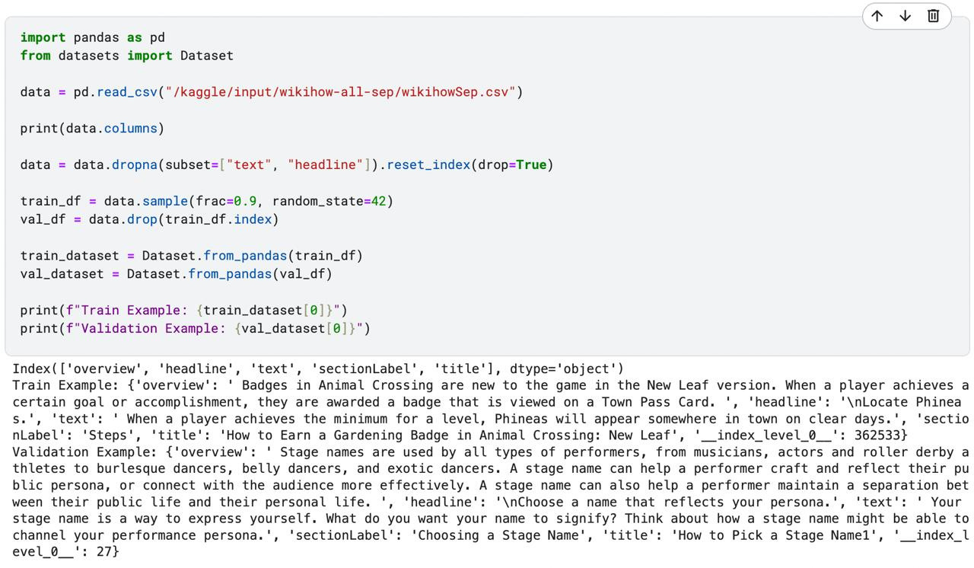
Dataset Overview

Slide 7
Transformer
The Transformer in NLP is a novel architecture that aims to solve sequence-to-sequence tasks while handling long-range dependencies with ease. It relies entirely on self-attention to compute representations of its input and output without using sequence-aligned RNNs.
The Transformer uses an encoder-decoder structure with multi-head self-attention to capture relationships and positional encoding for word order. It processes sequences in parallel, making it efficient for tasks like translation and summarization.

Slide 8
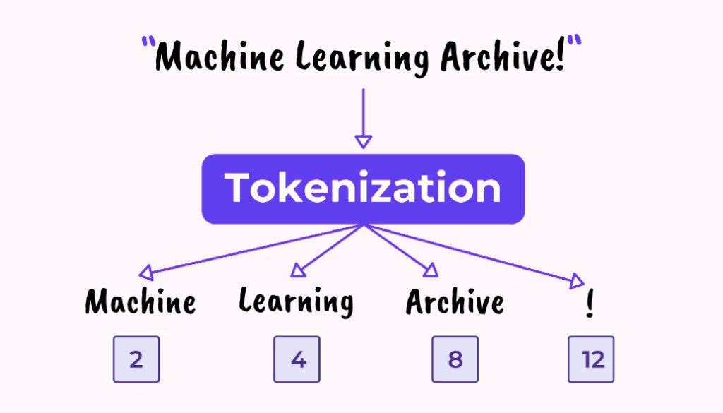
T5 Tokenizer
Converts raw text into a sequence of tokens (subwords) that the model can process.
Reconstructs output text from tokens to produce human-readable summaries.
Efficiently handles long and complex texts.
Improves generalization by breaking down words into meaningful subunits.

Slide 9

TRANSFORMER MODELS UTILIZED
BERT
Text-to-Text Transfer Transformer (T5)
Extractive Power of BERT in Text Summarization
T5’s Role in Generating Concise Summaries

Slide 10
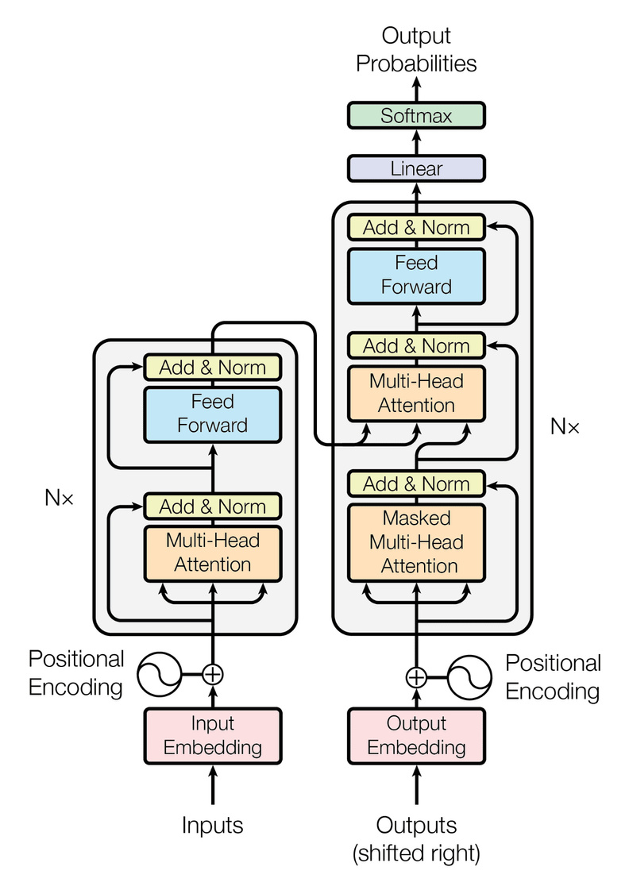
BERT
BERT (Bidirectional Encoder Representations from Transformers) is a pre-trained transformer model designed to understand the context of words in a sentence by looking at both left and right contexts.
Key Features
Contextual Understanding: Captures relationships between words in their full context
Extractive Summarization: Ideal for identifying key sentences and phrases from text.
Pre-trained Model: Reduces the need for extensive labeled data.

Slide 11
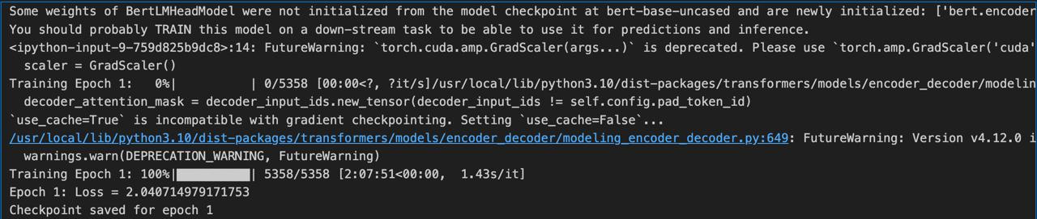
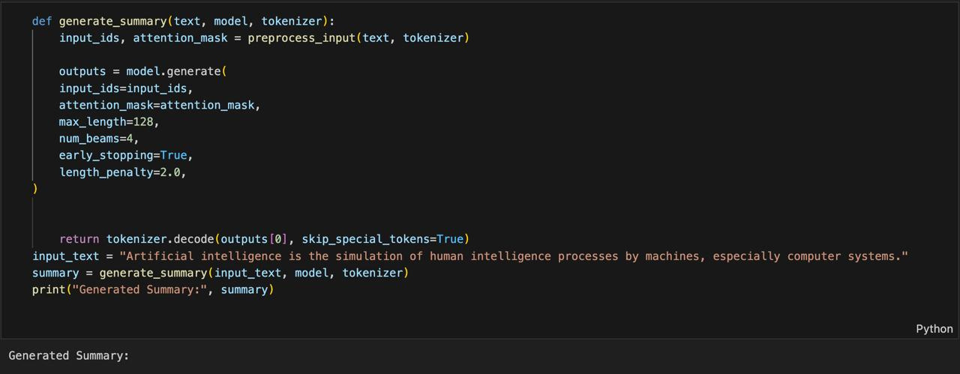
BERT In Action

Slide 12
Text-to-Text Transfer Transformer (T5)
T5 (Text-to-Text Transfer Transformer) is a transformer model developed by Google, designed to handle a wide range of NLP tasks in a unified text-to-text format. It treats every problem as converting an input text into an output text, making it ideal for abstractive summarization.
Key Features
Abstractive Summarization: Generates new sentences that may not exist in the original text.
Contextual Understanding: Excels in capturing long-term dependencies and semantic relationships.
Fine-Tuning Flexibility: Pre-trained on massive datasets, allowing customization for specific tasks.

Slide 13
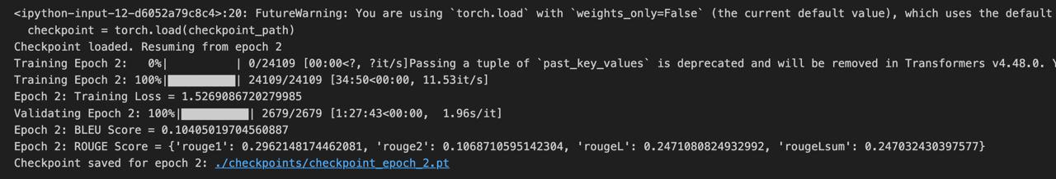
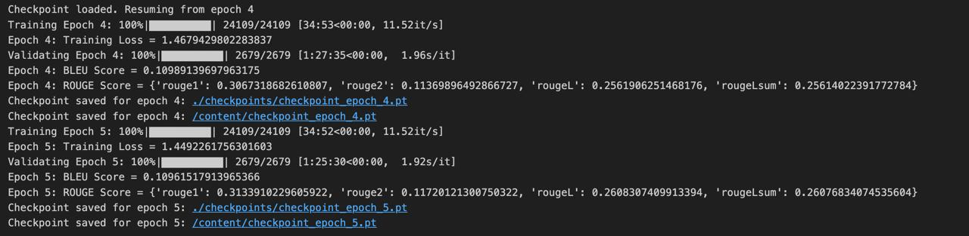
T5 In Action

Slide 14

MODEL EVALUATION
Rouge Score
Bleu Score
Recall-Oriented Understudy for Gisting Evaluation
Bilingual Evaluation Understudy

Slide 15
It measures the overlap between generated summaries and reference summaries.
Focuses on recall: How much of the important content in the reference summary is captured by the generated summary?
Variants: Rouge - 1, Rouge - 2, Rouge - L
Suitable for summarization tasks with extractive or abstractive methods.
ROUGE SCORE
 | Epoch - 2 | Epoch - 4 | Epoch - 5
Rouge - 1 | 0.2962148174462081 | 0.3067318682610807 | 0.3133910229605922
Rouge - 2 | 0.1068710595142304 | 0.11369896492866727 | 0.11720121300750322
Rouge - L | 0.2471080824932992 | 0.2561906251468176 | 0.2608307409913394

Slide 16
BLEU (Bilingual Evaluation Understudy) measures precision: How many words or phrases in the generated summary match the reference summary?
Includes a brevity penalty to penalize overly short summaries.
Popular for machine translation.
Scores:
Epoch 2 - 0.10405019704560887
Epoch 4 - 0.10989139697963175
Epoch 5 - 0.10961517913965366
BLEU SCORE

Slide 17
Code Walk Through

Slide 18

THANK YOU
Let’s do some Q&A

